Slide 1
HealthSearch:
A Desktop App for Ranking Hospitals
A Model by Team USA
Henry Williams, Miranda Luiz, Noah Crooks, Noah Roger

Slide 2

Our Modeling Methodology
What is the problem asking us to do?
Divide and conquer
Extensive research
Data, data, and more data
Use computers!

Slide 3
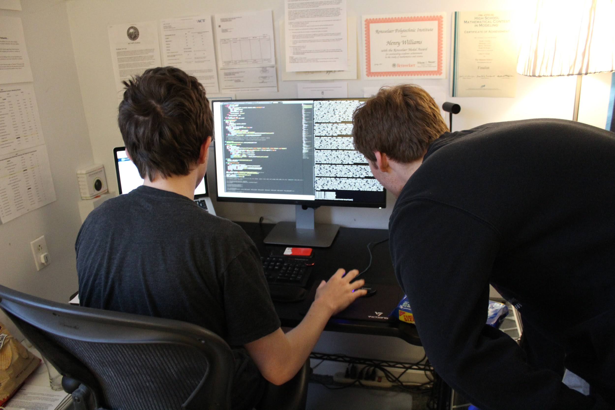
Approaching the Problem
What is an evitable death?
How are professionals attempting to answer this question?
What can we do that has not been done before, and is it mathematically justified?

Slide 4
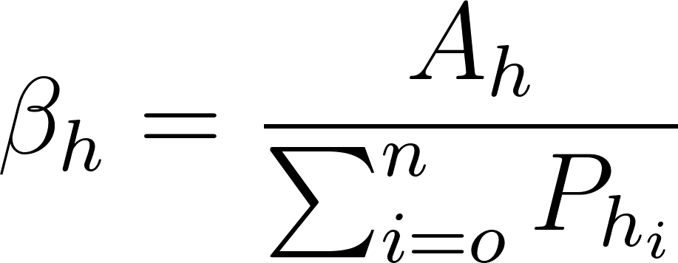
Hospital Standardized Mortality Rates
Our preliminary model ranked hospitals by their HSMRs.
Calculating a Patient-Adjusted Mortality Rate:
(Observed Deaths / Predicted Deaths Given Patient Factors)

Slide 5
Estimating Deaths Using Logistic Regression
Age group, gender, race, urgency of admission, whether the procedure was medical or surgical in nature, length of stay, and primary insurance type.
Based on New York State Statewide Planning and Research Cooperative System (SPARCS) program
Measures eligible for inclusion (N=37)
Measures included (N=7)
Unquantifiable measures(N=5)
Non-directional measures(N=2)
Overlapping measures(N=1)
Organizational measures(N=22)

Slide 6

Fixing Imbalanced Data
Over-sampling using Synthetic Minority Over-Sampling Technique
Under-sampling using Tomek links removal method
Imbalanced weighting scheme.

Slide 7
Issues with the Mortality-Rate Approach
Lack of important clinical information from routinely collected data
Disease severity is not taken into account
Does not take into account other relevant information that affects the quality of a hospital
 | Precision | Recall | F1-Score
Alive | .68 | .96 | .80
Dead | .90 | .41 | .56
Avg/Total | .78 | .73 | .70

Slide 8


In Search of a Holistic Model
Measure Group or Multi-Group
Outcome (mortality, readmission) | 30% (15%, 15%)
Structure (timeliness, effectiveness) | 35% (17.5%, 17.5%)
Imaging | 5%
Safety | 5%
Patient Experience | 25%

Slide 9



Latent Variable Modeling
Problem: Available data appears as 47 different metrics in 7 categories with unclear relationships to overall hospital quality
Solution: Use computational probability to infer how much each metric is affected by a “hidden” latent variable of hospital quality.

Slide 10
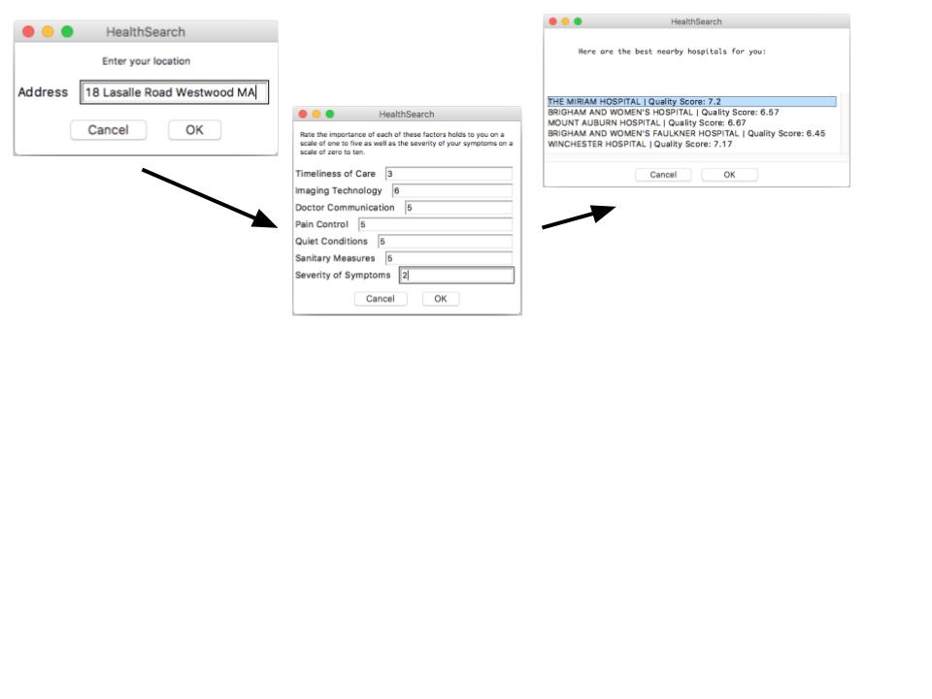


Personalization to User

Slide 11
The HealthSearch Program

Slide 12
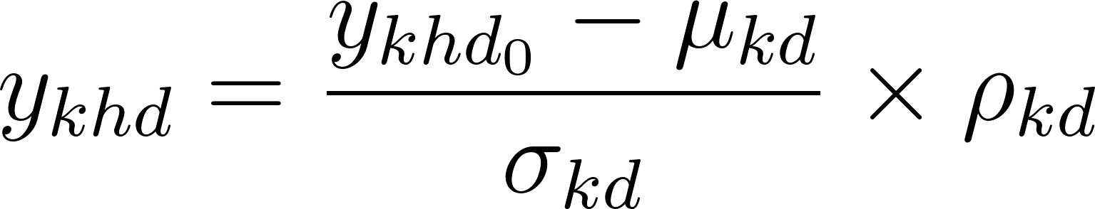
Data Problems and Value Standardization
When dealing with real data, different metrics (e.g. mortality rates and customer satisfaction scores) have different ranges and values
For some higher = better, others lower = better
To put them all in the same format, we can look at the mean and standard deviation of each value.
These dimensionless quantities are known as z-scores, defined as the number of standard deviations above or below the population mean a value is.

Slide 13
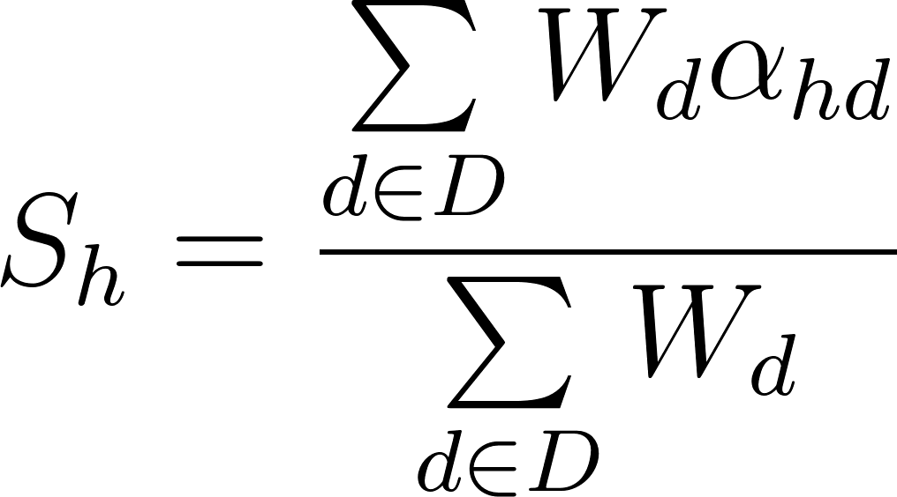
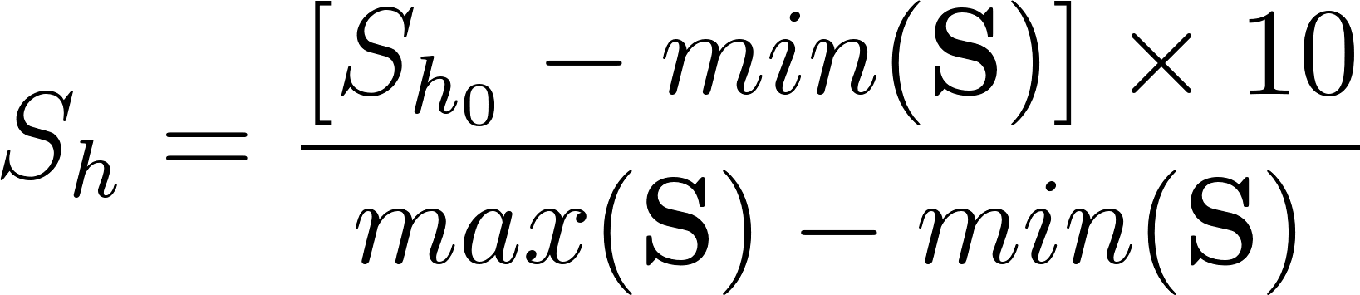
FINAL METRIC: Holistic Hospital Quality Score
Once we have calculated the latent variable for each group of measures, and determined a weight based on user input, we calculate a find hospital quality score given as S_{h}.
We also take all the scores and resize them to form a distribution between 0 and 10 with the average score at 5.

Slide 14
Outputs of HealthSearch with User Input
 | Initial Score | Prioritized S+E score | Prioritized q score | Distance (mi)
Advocate Good Samaritan Hospital | 6.1 | 6.0 | 7.6 | 9.8
Central Dupage Hospital | 5.7 | 5.9 | 7.0 | 1.9
Elmhurst Memorial Hospital | 5.6 | 5.6 | 7.0 | 11.1
Edward Hospital | 5.3 | 5.4 | 6.9 | 9.3
Adventist Glenoaks | 3.8 | 4.3 | 5.0 | 8.7
 | Initial Score | Prioritized S+E score | Prioritized q score | Distance (mi)
Rochelle Community Hospital | 6.8 | 7.3 | 7.0 | 56.5
Northwestern Memorial Hospital | 6.6 | 6.3 | 8.5 | 31.8
Delnor Community Hospital | 6.5 | 6.3 | 8.2 | 11.5
Midwestern Regional Medical Center | 6.4 | 7.2 | 6.6 | 67.5
Silver Cross Hospital | 6.1 | 6.3 | 6.6 | 31.3

Slide 15
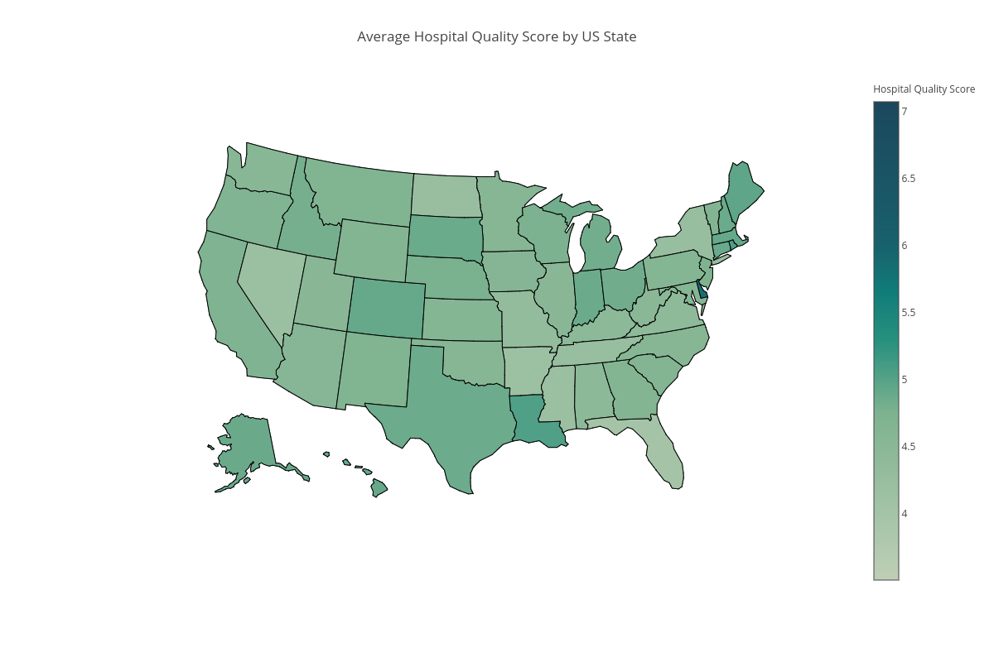
Applications and Extensions of HealthSearch
Hospital | Quality Score | Facebook score | Google score | Yelp score | Miscellaneous
Park Place Surgical Hospital | 10 | 9.6 | 9.6 | 10 | A+ (Better Business Bureau)
Mayo Clinic Hospital | 8.1 | 8.6 | n/a | 9 | 7.2 (Consumer Affairs)
New England Baptist Hospital | 8.2 | 9.6 | 8.8 | 8 | 7.4 (Glassdoor)

Slide 16
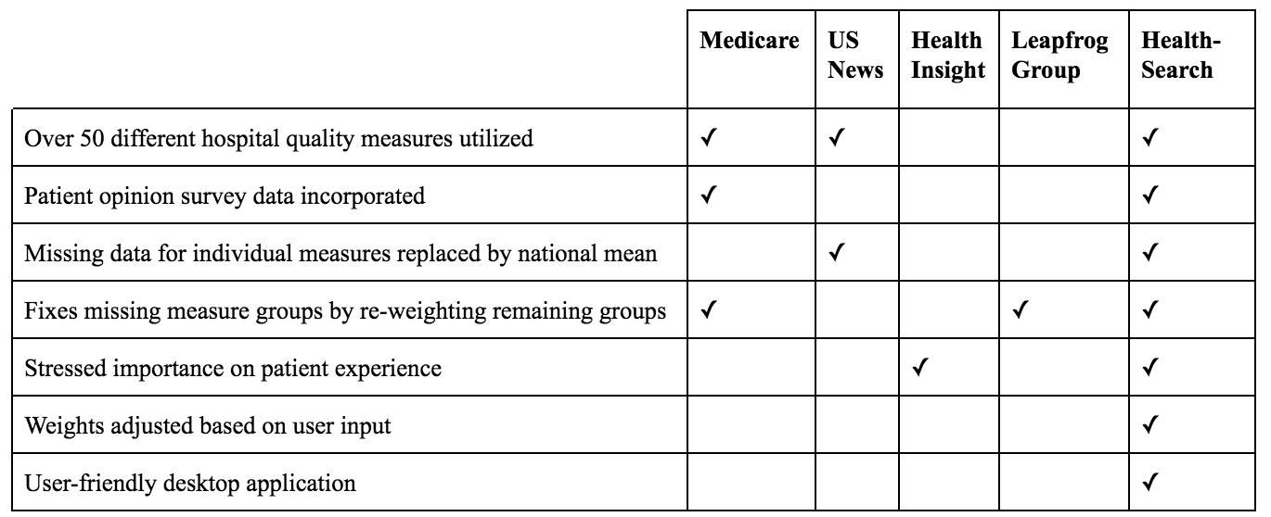
Comparison of Hospital Ranking Systems

Slide 17
Strengths
Latent Variable Modeling
Our weights are derived from multiple authoritative sources.
Our holistic model utilizes over 50 diverse measures of hospital quality.
Our model modifies the weight metric based on user input.
Our model replaces unknown measure data with the national mean.
Our model avoids expert bias.

Slide 18
Weaknesses
Our model is probabilistic.
Symptom severity is not directly correlated to outcome.
Our weights can not be 100% accurate.
HealthSearch survey obtains a limited amount of information from the user.
Missing data
Over-sampling the New York State dataset creates overfitting of the minority variable in our HSMR regression. While overfitting was mitigated by class weighting, some overfitting was inevitable. Also, our regression uses a measure for amenable deaths with high specificity, but low sensitivity.

Slide 19
References (Abridged)
Austin, J. M., Jha, A. K., Romano, P. S., Singer, S. J., Vogus, T. J., Wachter, R. M. and Pronovost, P. J. (2015) “National Hospital Ratings Systems Share Few Common Scores And May Generate Confusion Instead Of Clarity,” Health Affairs, 34(3), pp. 423–430. doi: 10.1377/hlthaff.2014.0201.
Data By Hospital - Dartmouth Atlas of Health Care (no date) The Dartmouth Atlas of Health Care. Available at: http://www.dartmouthatlas.org/data/hospital/.
Doyle, J., Graves, J. and Gruber, J. (2017) “Evaluating Measures of Hospital Quality.” doi: 10.3386/w23166.
Geweke, J., Gowrisankaran, G. and Town, R. (2001) “Bayesian Inference for Hospital Quality in a Selection Model.” doi: 10.3386/w8497.
Henderson CR. Best Linear Unbiased Estimation and Prediction under a Selection Model. Biometrics 1975;31:423-47.
HCUPnet (no date) HCUPnet. Available at: https://hcupnet.ahrq.gov/#setup.
Hosmer, D. W. and Lemeshow, S. (2007) Confidence interval estimates of an index of quality performance based on logistic regression models, Statistics in Medicine. Wiley-Blackwell. Available at: https://onlinelibrary.wiley.com/doi/pdf/10.1002/sim.4780141909.
Hosmer, D. W. and Lemeshow, S. (1995) “Confidence interval estimates of an index of quality performance based on logistic regression models,” Statistics in Medicine, 14(19), pp. 2161–2172. doi: 10.1002/sim.4780141909.
Landrum M, Bronskill S, Normand S-L. Analytic Methods for Constructing Cross-Sectional Profiles of Health Care Providers. Health Services and Outcomes Research Methodology 2000;1:23-47.
Luft, H. S. (1986) “Evaluating individual hospital quality through outcome statistics,” JAMA: The Journal of the American Medical Association, 255(20), pp. 2780–2784. doi: 10.1001/jama.255.20.2780.
Murrey G. Olmsted et al. (2017)”U.S. News & World Report 2017-18 Best Hospitals: Specialty Rankings.
Shojania, K. G. and Forster, A. J. (2008) “Hospital mortality: when failure is not a good measure of success,” Canadian Medical Association Journal, 179(2), pp. 153–157. doi: 10.1503/cmaj.080010.
Shwartz, M., Ren, J., Peköz, E. A., Wang, X., Cohen, A. B. and Restuccia, J. D. (2008) “Estimating a Composite Measure of Hospital Quality From the Hospital Compare Database,” Medical Care, 46(8), pp. 778–785. doi: 10.1097/mlr.0b013e31817893dc.
Wang, X. (2014) “Firth logistic regression for rare variant association tests,” Frontiers in Genetics, 5. doi: 10.3389/fgene.2014.00187.
Yvette R. B. M. Van Gestel, Lemmens, V. E. P. P., Lingsma, H. F., Ignace H. J. T. De Hingh, Rutten, H. J. T. and Coebergh, J. W. W. (2012) “The Hospital Standardized Mortality Ratio Fallacy,” Medical Care, 50(8), pp. 662–667. doi: 10.1097/mlr.0b013e31824ebd9f.

Slide 20


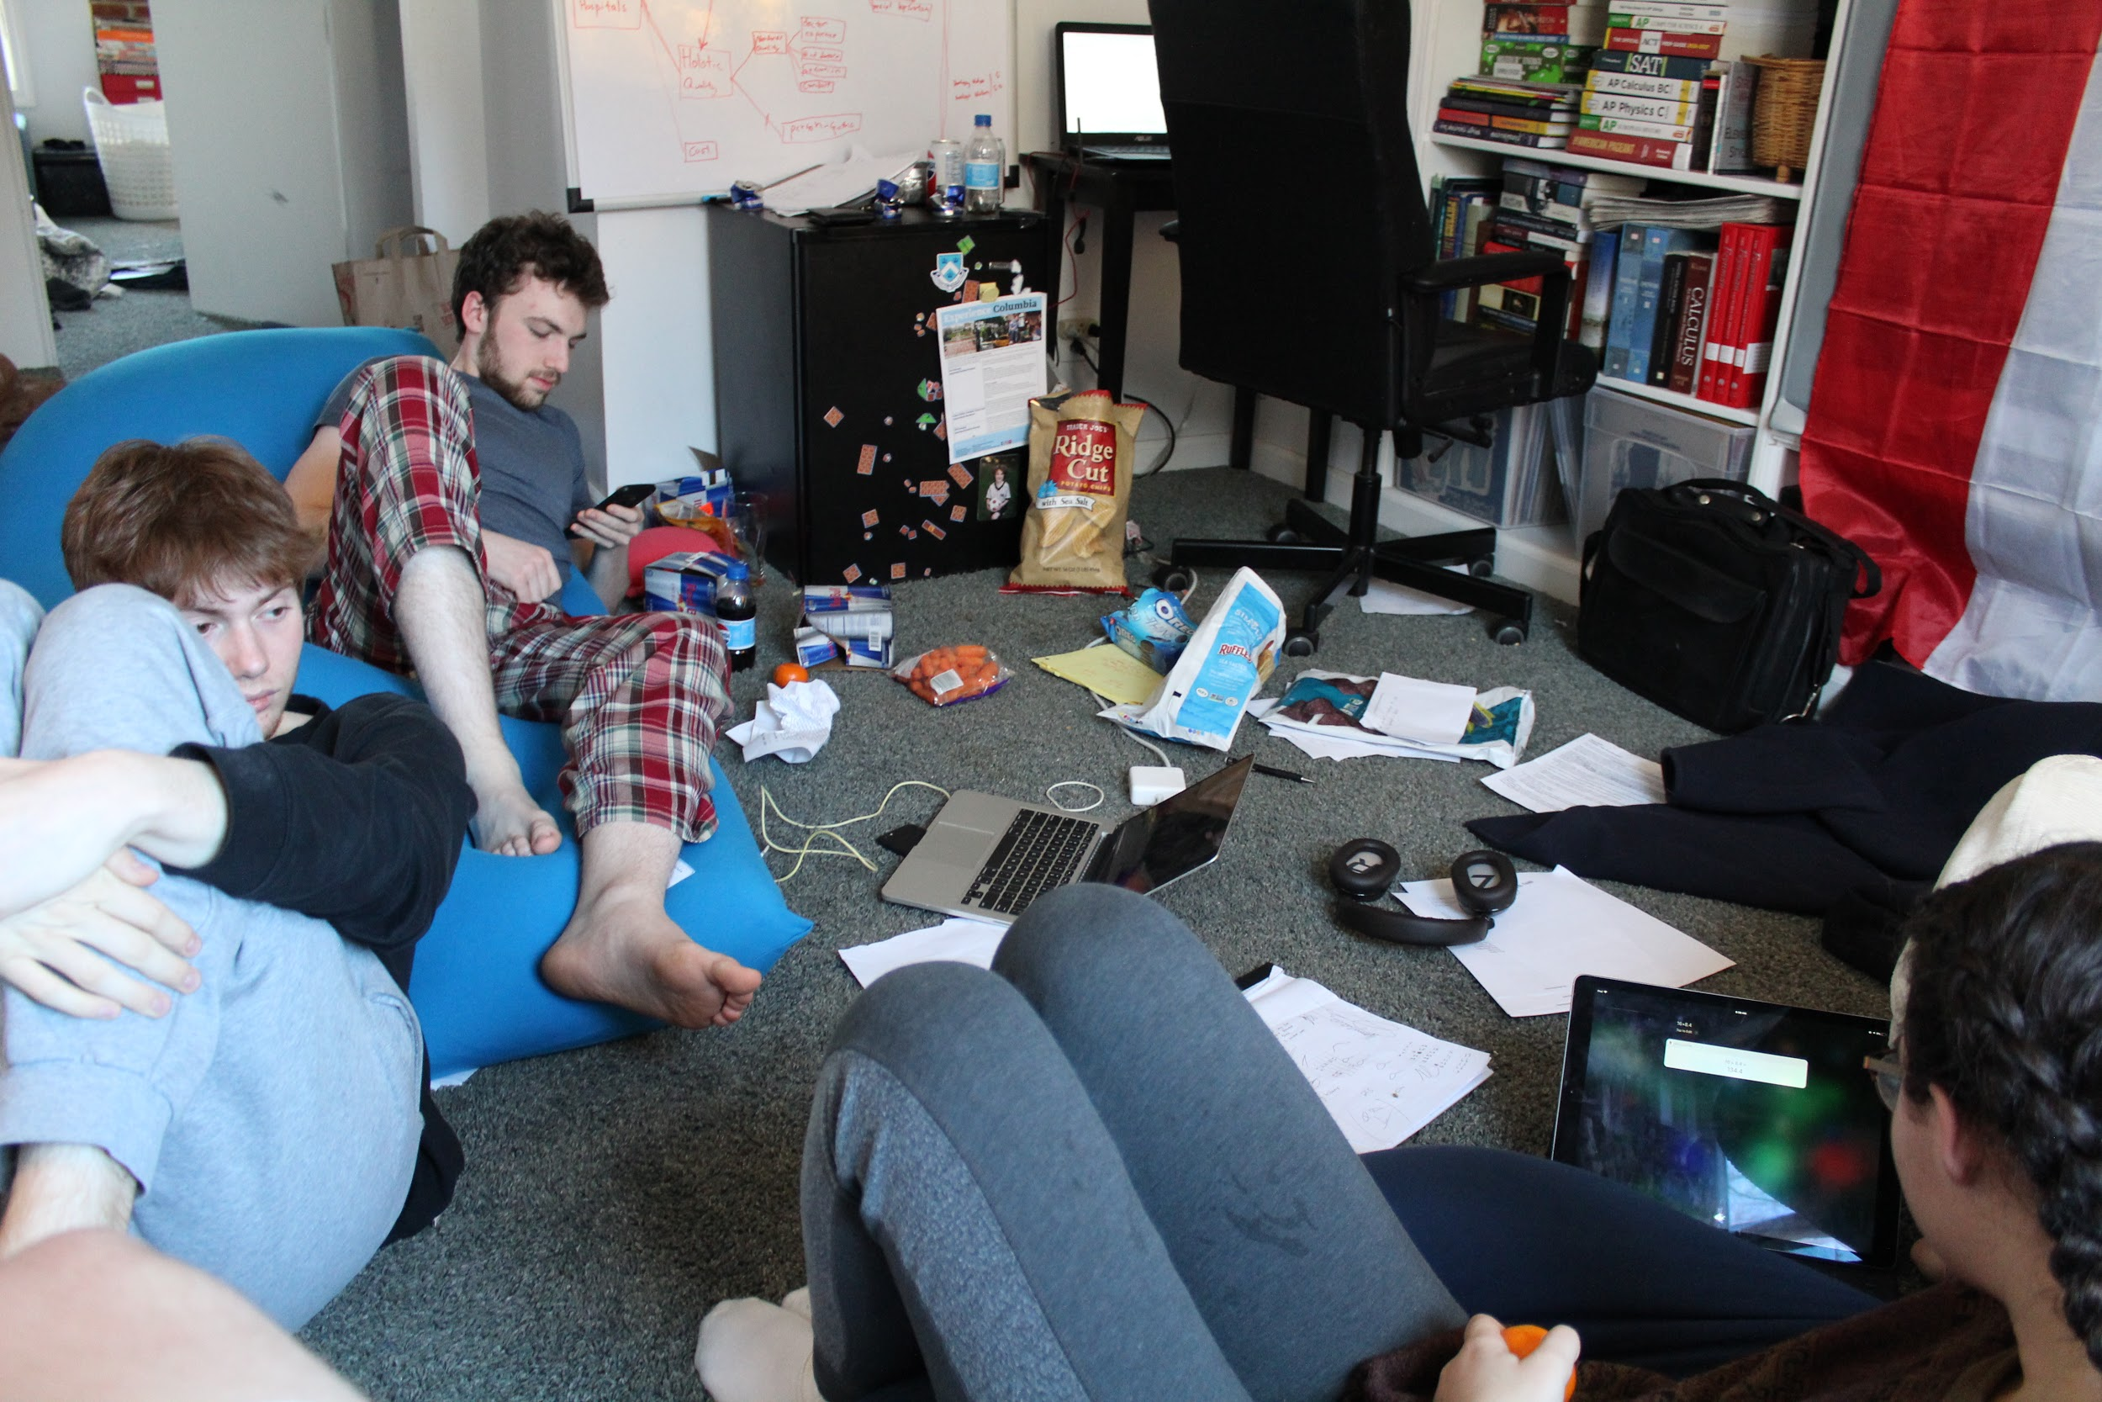
Our Experience with Math Modeling
Between the four of us, we have done 12 competitions across 4 years
These competitions have influenced our interest in going into the areas of math, physics, biology and computer science
The experience is much different than in our math classes
As a team we have become lifelong friends and push each other to do better

Slide 21

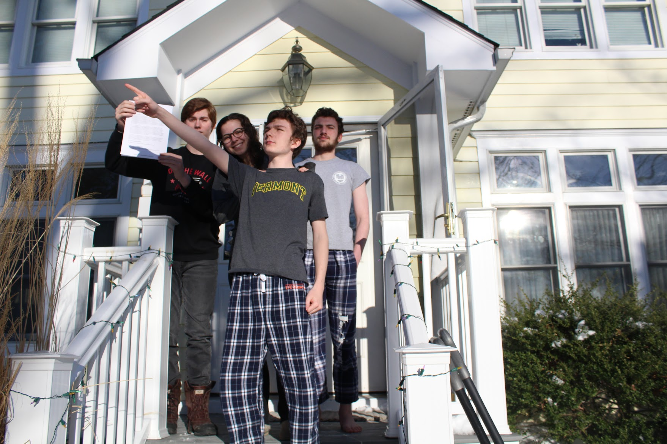
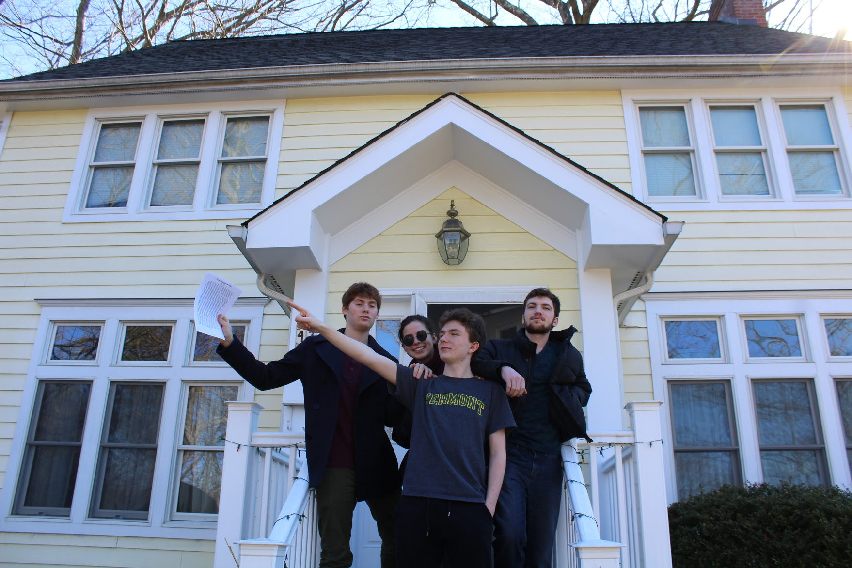

Thank you to the IM²C and COMAP for four years of competitions!
Any Questions?

